Slide 1
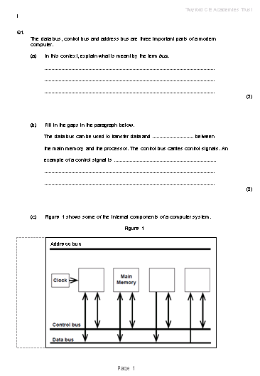
FEC and Registers
LO: To understand the role of each register in the FEC
Prep Check

Slide 2
FEC and Registers
LO: To understand the role of each register in the FEC
Specification Point
3.7.3.2 The fetch–execute cycle and the role of registers within it
3.7.3.6 Factors affecting processor performance

Slide 3
FEC and Registers
LO: To understand the role of each register in the FEC
Task
Fetch-Execute Cycle Animation Card Sort

Slide 4
FEC and Registers
LO: To understand the role of each register in the FEC
Fetch-Execute Cycle Animation

Slide 5
The Fetch-Execute cycle
+1
Program Counter
0000 0000 0000 0011
0000 0000 0000 0100
0000 0000 0000 0011
Address Bus
Main Memory
Memory Address Register
1
0101 0000 0000 0110
2
Memory Buffer Register
0101
0000 0000 0110
3 0101 0000 0000 0110
“ADD #6”
Data Bus
4
5
Current Instruction Register (CIR)
Op-code
Operand
6
:
Fetch
Instruction Decoder
Accumulator
MAR ← [PC]
0000 0000 0000 0100
PC ← [PC] + 1
MBR ← memory contents
CIR ← [MBR]
ALU

Slide 6
The Fetch-Execute cycle
+1
Program Counter
0000 0000 0000 0011
0000 0000 0000 0100
0000 0000 0000 0011
Main Memory
Address Bus
Memory Address Register
0000 0000 0000 0011
1
2
Memory Buffer Register
0101 0000 0000 0110
3 0101 0000 0000 0110
“ADD #6”
Data Bus
4
5
Current Instruction Register (CIR)
Op-code
Operand
6
0101
0101
0000 0000 0110
0000 0000 0110
:
“ADD operand to accumulator”
Instruction Decoder
Execute
Accumulator
End of F-E Cycle
0000 0000 0000 0100
0000 0000 0000 0100
Decode instruction
+
Execute instruction
ALU
0000 0000 0000 1010
6 + 4
= 10

Slide 7
FEC and Registers
LO: To understand the role of each register in the FEC
Register Transfer Notation
MAR ← [PC]
PC ← [PC] +1; MBR ← [Memory]
CIR ← [MBR]
[CIR] decoded and executed

Slide 8
FEC and Registers
LO: To understand the role of each register in the FEC
Describing the FEC Process
1 | Contents of Program Counter transferred to MAR
2 | Program Counter incremented; Contents of the memory address which is held in the MAR is transferred to MBR from Main Memory
3 | Contents of MBR transferred to the CIR
4 | [CIR] decoded and executed

Slide 9
FEC and Registers
LO: To understand the role of each register in the FEC
FEC additional points
Fetch:
Some instructions need to load a number of bytes or words, so they may need to be fetched as successive parts of a single instruction.

Slide 10
FEC and Registers
LO:
Factors affecting performance
Clock speed: Clock speed is one measure of the performance of the computer.
Bus width: Increasing the width of the data bus means that more bits, and therefore more data, can be passed down it with each pulse of the clock.
Word length: Related to the data bus width is the word length. A word is a collection of bits that can be addressed and manipulated as a single unit.

Slide 11
FEC and Registers
LO:
Factors affecting performance
Multiple cores: Many computer systems have one processor. One way of increasing system performance is to use several processors.
Cache memory: Caching is a technique where instructions and data that are needed frequently, are placed into a temporary area of memory that is separate from main memory.

Slide 12
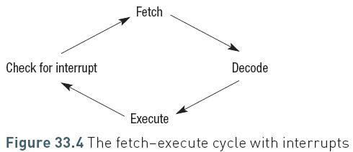
FEC and Registers
LO: To understand the role of each register in the FEC
Interrupts and the FEC
Processor stops what it is doing in order to service the interrupt.
The Interrupt Service Routine (ISR) calls the routine required to handle the interrupt.
Most interrupts are only temporary
Processor places the contents of the registers, such as the PC and CIR on to the system stack. Once the interrupt has been processed the CPU will retrieve the values from the stack, put them back in the appropriate registers and carry on.

Slide 13
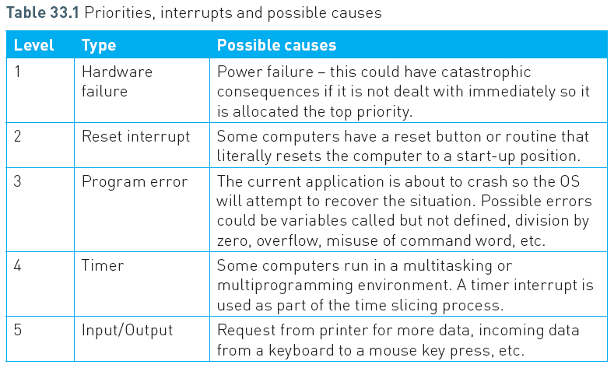
FEC and Registers
LO: To understand the role of each register in the FEC
Interrupt priorities

Slide 14
FEC and Registers
LO: To understand the role of each register in the FEC
Question: Interrupt priorities
What if an interrupt is being processed and then another interrupt is received?
What would happen? (think about what would happen to the data in the registers)

Slide 15
FEC and Registers
LO: To understand the role of each register in the FEC
Vectored interrupt mechanism
Interrupts have code to determine how they should be handled
The processor needs to know where the first instruction for this code is located in main memory
The starting address for each interrupt process is held in a vector
So when an interrupt occurs, the processor identifies what kind of interrupt it is, then finds its associated interrupt vector. It then uses this to jump to the address specified by the vector, from where it runs the Interrupt Service Routine (ISR).

Slide 16
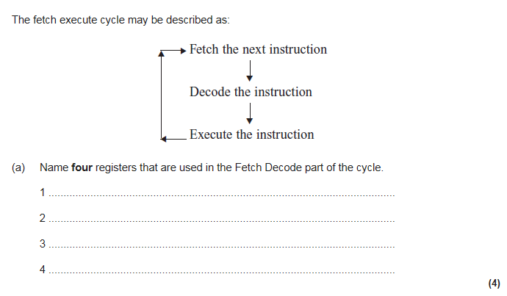

Slide 17
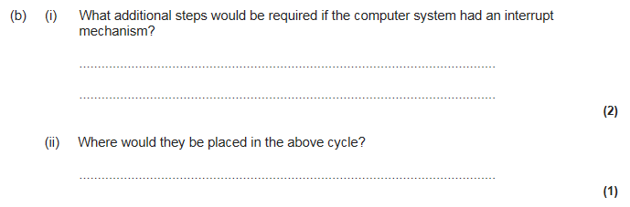

Slide 18
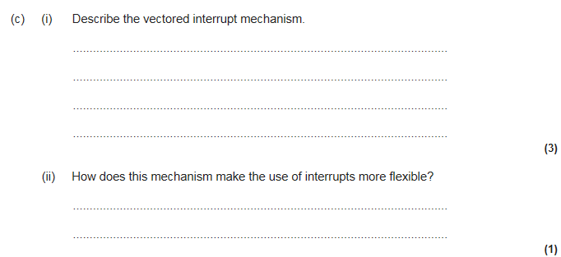

Slide 19
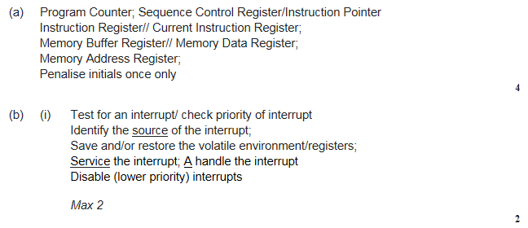

Slide 20
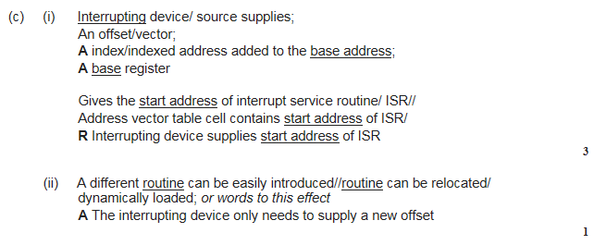

Slide 21
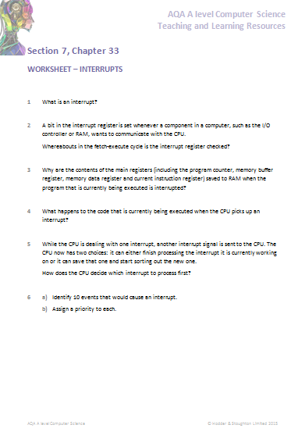
FEC and Registers
LO: To understand the role of each register in the FEC
Prep
Complete the prep task on Copia

Slide 22















Key words:
Noted clearly
Topic specific vocabulary wherever necessary
Icon for extension activity if appropriate
Icon same colour as dept ex book
You might want to develop subject specific icons

